Slide 1
Welcome to our project
This project was done by Jocelyn’s team: Jocelyn, Lana, Bara’a, Reham, Yara.
This PowerPoint tells you about our project and our projects outcomes!

Slide 2
Eye cancer
Today we are here to make it easier for doctors to know more about eye cancer patients and also allow them to find the information they need from a dataset. So, instead of going through each record they can get the information they need by a click of a button by running our code!
Why eye cancer?
Eye cancer is more common than you think and its often not talked about as much, so we decided to give it the attention it deserves and make analysis and data preprocessing on an eye cancer dataset while also training our model to make some predictions and making it as interactive as we can.
We wanted to combine the world of Data Science and the world of Medicine one of the most important fields nowadays, Lets see how that went!

Slide 3
What are we going to cover in our project?
Our project works the same way as a movie series does!
We have the dataset we did some operations to find the amount of null values in It , turns out it had null values so we fixed that.
We worked hard on making it interactive so anyone can access the information they need from our dataset.
We also made an automated part which was training our model using Gaussiannb using supervised learning.
We calculated the confusion matrix and visualized it too.

Slide 4
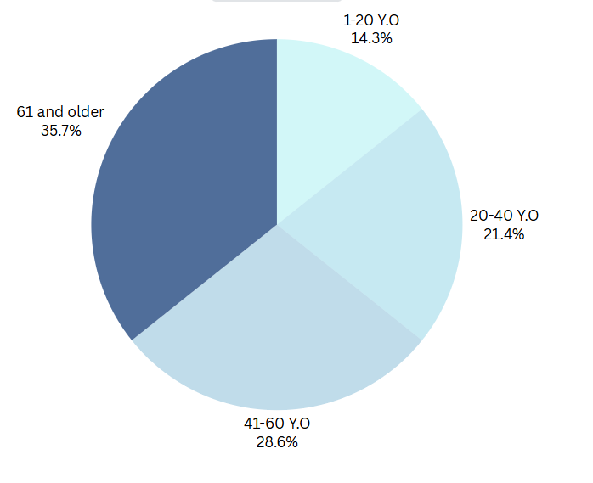
Distribution of eye cancer among different ages

Slide 5
Analyses on the treatment
 | Chemo/ radiation | surgery
Melanoma | True | True
Lymphoma | True | True
Retinoblastoma | False | True
According to the records most melanoma gets treated with chemo and radiation and some of it requires surgery
According to the records we also found the same thing about lymphoma
Retinoblastoma’s all cases were treated with surgery according to our records.

Slide 6
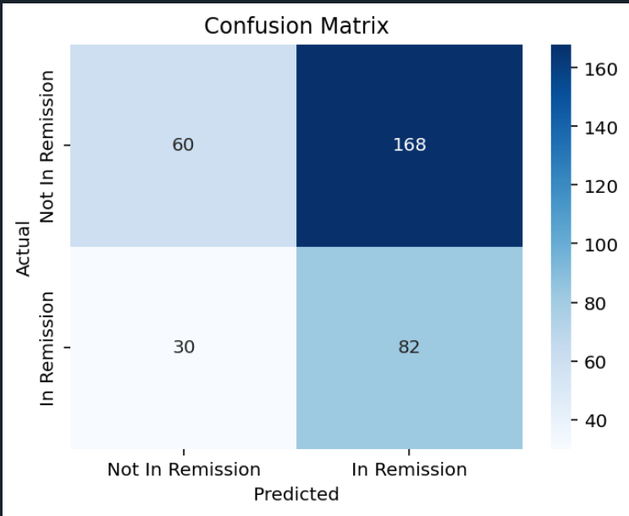
About our model
We developed our model suing supervised learning and it predicted this.

Slide 7
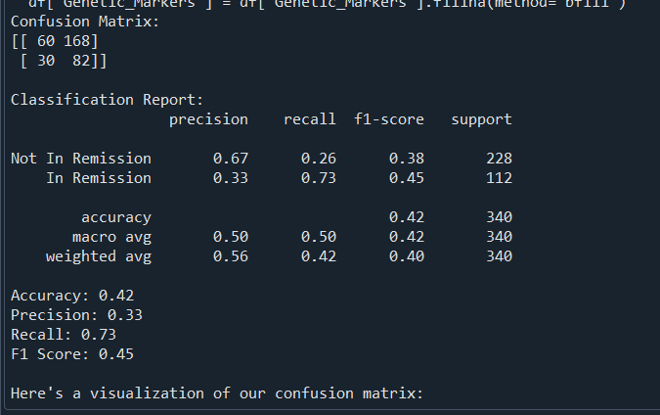
More of our model
Our model predicted this confusion matrix.

Slide 8
Summary of our project
Our project is the perfect way for doctors to learn more about eye cancer while also enabling them to touch data with their own hands.
We made our project very interactive, any doctor can choose the row they want from the column they want.
The doctor may ask and we deliver!

Slide 9
THAT’S IT!
That’s it for this project, we tried our best to make the world of Data science get along with the world of Medicine.
Have fun using our project!

